Slide 1
Modeling Market Mechanism with Minority Game
Yuhang Liu & Hunter Wang

Slide 2
Motivation
The ability to predict the movement of a financial market has always been a highly valued and heavily researched area since people can receive huge financial rewards if a model applies to the financial market and makes correct predictions.
In real market, the amount of investment in a product is unstable and usually fluctuates: sometimes it goes up and sometimes it goes down. It’s hard to predict the change in the future.

Slide 3
Problem Description
Investors have many choices when making investments.
The actual profits they can get depends on the competition in the area they invest in.
The more intense the competition is, the harder they can get profits.
They have to decide which product to invest before they know the market situation.

Slide 4
Purposes
Observe the pattern in market.
Find factors affecting the pattern.
Work out a new strategy that makes more profits.

Slide 5
Expected Results
The pattern of fluctuation is periodic.
The market fluctuates with randomness.
Products with higher default prices are generally more popular than products with lower default prices.
A new strategy that takes the pattern of periodic fluctuation into consideration can make more profit on average.

Slide 6
Research Questions
How does the market fluctuate?
Is the fluctuation periodic?
If the fluctuation is periodic, what is the period?
How do the default profits of products affect people’s decisions?
How can we come up with better strategies?

Slide 7
Assumptions
Agents make decisions by predicting how many agents will invest in each product using “strategies”.
Each agent has finite number of strategies to choose from and does not come up with new strategies during the simulation.
Only the record of previous several rounds could affect an agent’s decisions.
Each agent chooses to use the strategy that makes the best prediction to the record of several previous rounds.

Slide 8
Variables and Constants
Constants:
Number of agents: N
Number of strategies: S
Memory size: M
Default profits for three products: P1, P2, P3
Variables:
Number of agents choosing each product: N1, N2, N3
Actual profits for three products: Q1, Q2, Q3

Slide 9
Modeling Approach
Environment Setup
Agent Properties
Strategies

Slide 10
Environment Setup
At the beginning of simulation, a history that is twice the memory size is randomly created for agents to make initial decisions.
For each round of investments, the agents make decisions based on their strategies before they gain profits according to the investments.
The actual profit for a certain product is calculated using the formula: Profit = (default profit) * (one third of the total number of agents) / (the number of agents investing on this product)

Slide 11
Agent Properties
There is no direct spatial interaction between agents.
Each agent is equipped with a list of random strategies which are used to make predictions of the market.
The lists of strategies are different from agent to agent, and agents never change their lists of strategies.
Agents have memory: a record of market situations for previous several rounds.
Agents learn from their memory: they choose from their lists of strategies the strategy that makes the best estimation for the records in their memory.

Slide 12
Strategies
Agents use strategies to predict market.
Assume the memory Size is n. Then one strategy is a 3 by n matrix with its entries random numbers between -1 and 1. These numbers represent how much weight is put on each product for each previous round.
Estimation E = S1 * M1 + S2 * M2 + … + Sn * Mn, where S’s are the weights and M’s are the numbers of agents for each round in the memory.
With a prediction of number of agents investing on each product, the agent can then predict the profits it can gain from each product and choose product with the highest predicted profit.

Slide 13



Example for Memory Size 3
Strategy
History of 6 rounds Memory
Estimation for round 7

Slide 14
Choosing the Best Strategy
An agent chooses to use the best strategy from its strategy list by learning from its memory.
The agent chooses the strategy that best fits the data in its memory to be the best strategy.
The goodness of fit for a strategy is measured by the sum of squared errors for its predictions to all records in the agent’s memory: Error = (E1 - M1) ^ 2 + (E2 - M2) ^ 2 + … + (En - Mn) ^ 2, where n is the memory size, E’s are the predicted values and M’s are the observed values in the memory.

Slide 15


Continued Example for Memory Size 3
Strategy
History of 6 rounds
Estimation for round 4
Error for round 4

Slide 16


Continued Example for Memory Size 3
Strategy
History of 6 rounds
Estimation for round 5
Error for round 5

Slide 17


Continued Example for Memory Size 3
Strategy
History of 6 rounds
Estimation for round 6
Error for round 6

Slide 18
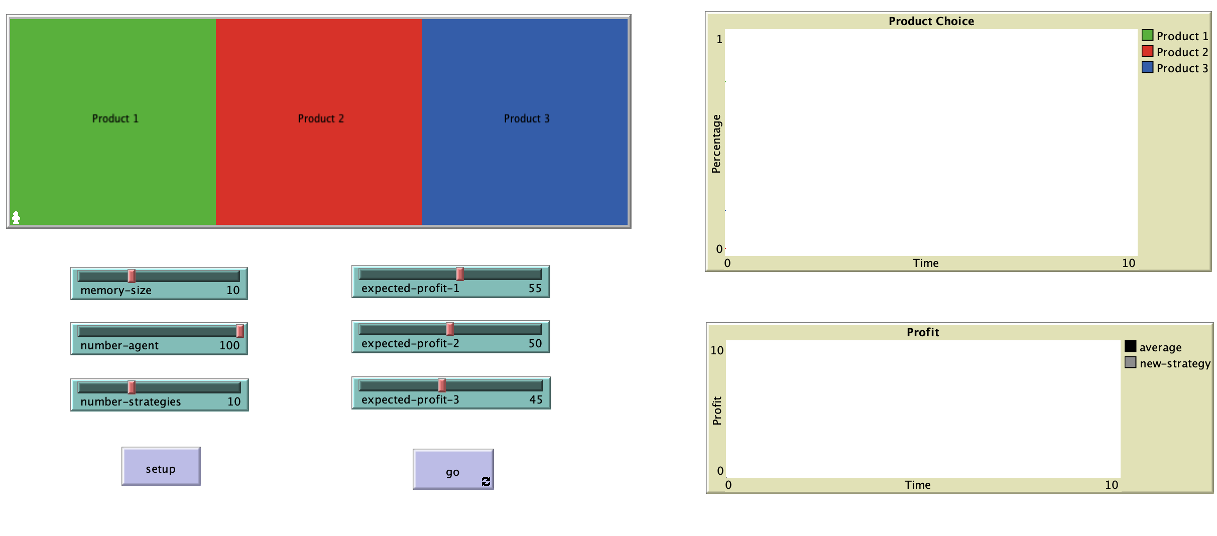
Interface

Slide 19
Simulation and Experiments (1)
Memory Size
Number of Strategies: 15
Number of Agents: 100
Expected Profits for 3 products: 55, 50, 45
Compare the patterns of the Product Choice plot when Memory Size is 6, 8, 10, 12

Slide 20
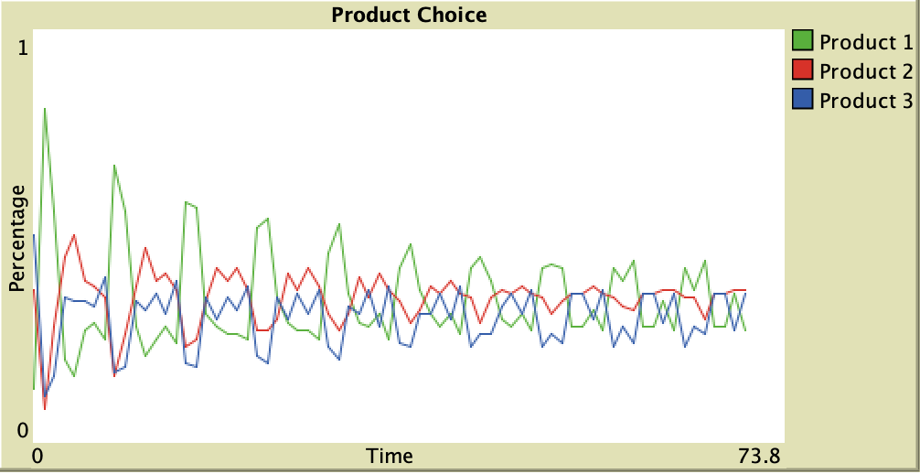
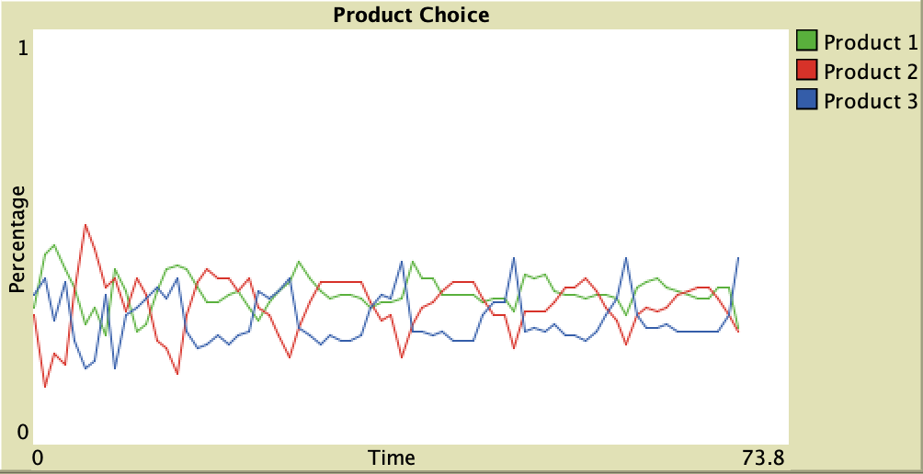
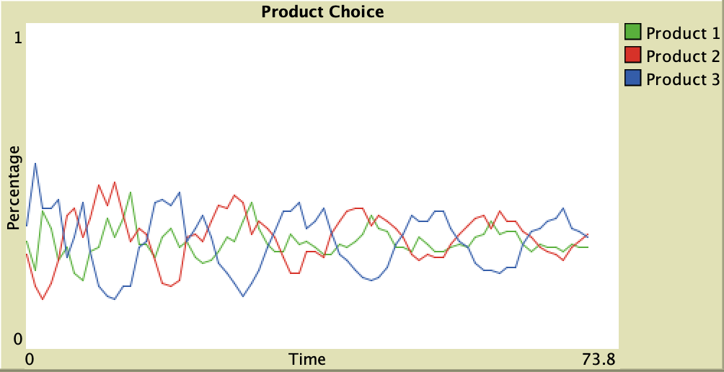
Memory Size = 6
Period = 7
Memory Size = 8
Period = 9
Memory Size = 10
Period = 11
Memory Size = 12
Period = 13

Slide 21
Simulation and Experiments (2)
Number of Strategies
Memory Size: 10
Number of Agents: 100
Expected Profits for 3 products: 55, 50, 45
Compare the patterns of the Product Choice plot when Number of Strategies is 5, 10, 15, 20

Slide 22
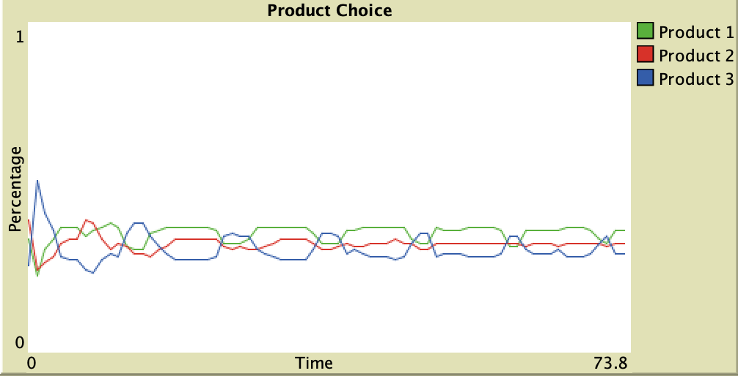
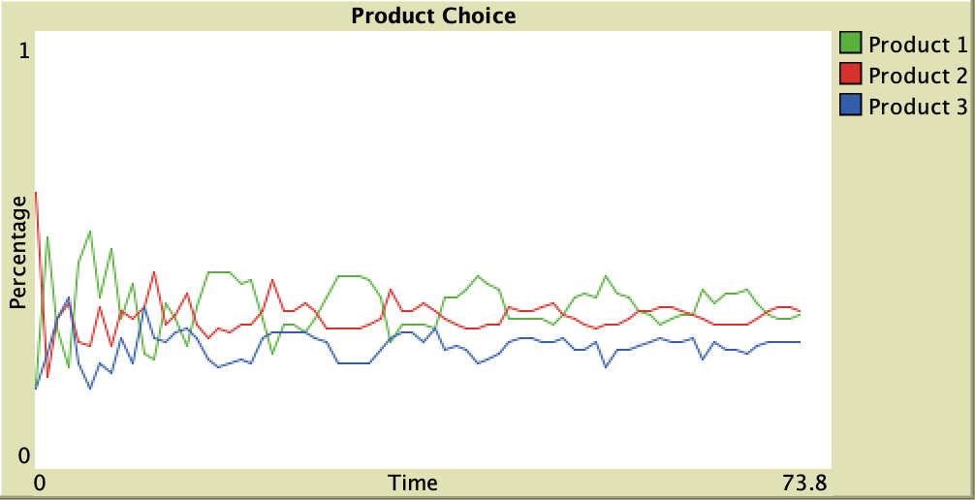
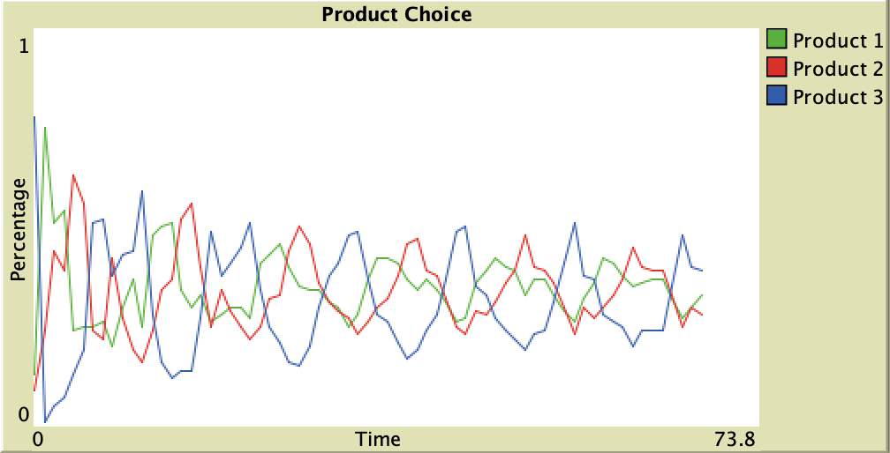
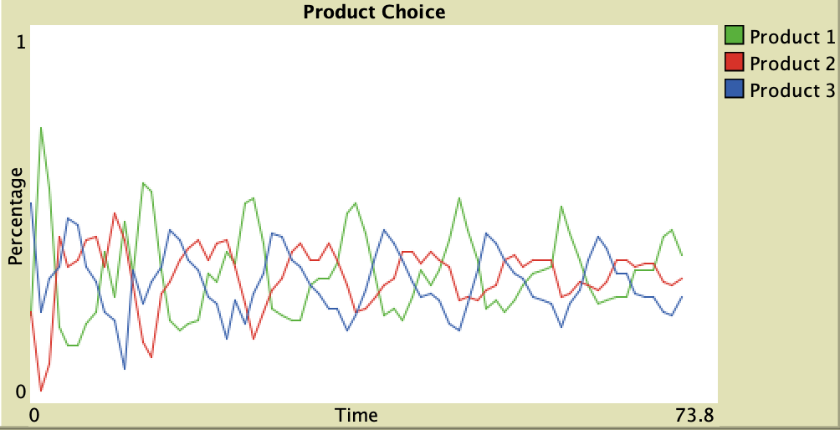
Number of Strategies = 5
Number of Strategies = 10
Number of Strategies = 15
Number of Strategies = 20

Slide 23
Simulation and Experiments (3)
Default Profits
Memory Size: 10
Number of Agents: 100
Number of Strategies: 15
Compare the patterns of the Product Choice plot when the Default Profits for 3 products are different sets of values

Slide 24
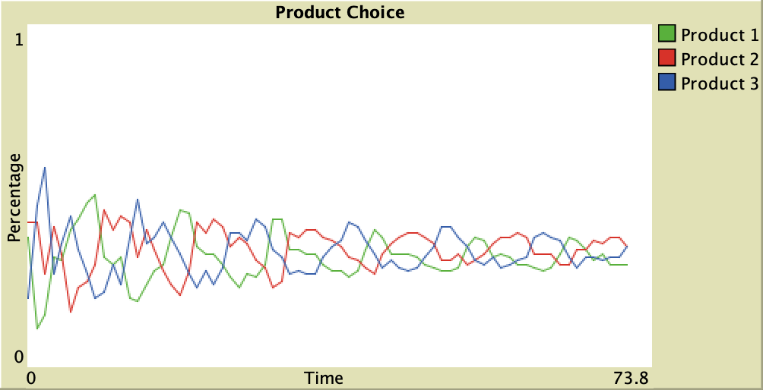
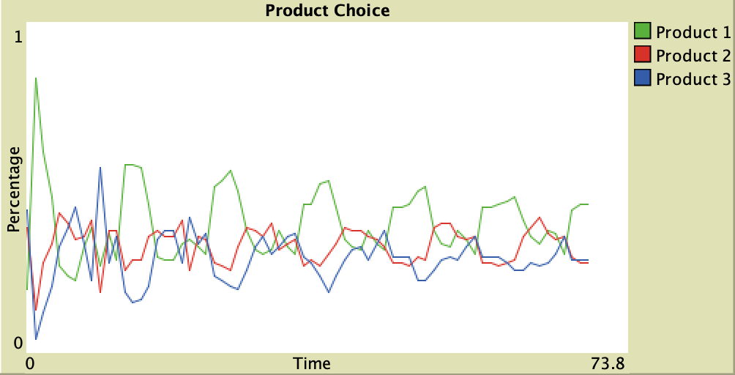
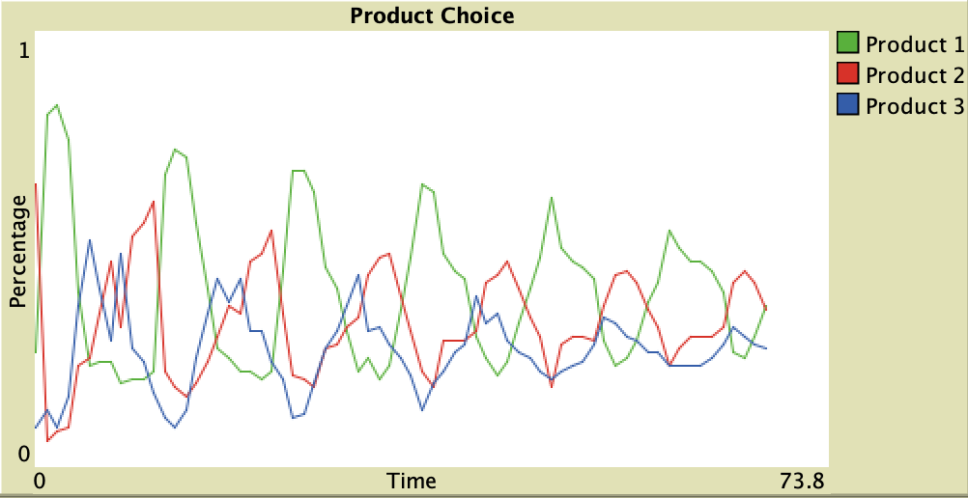
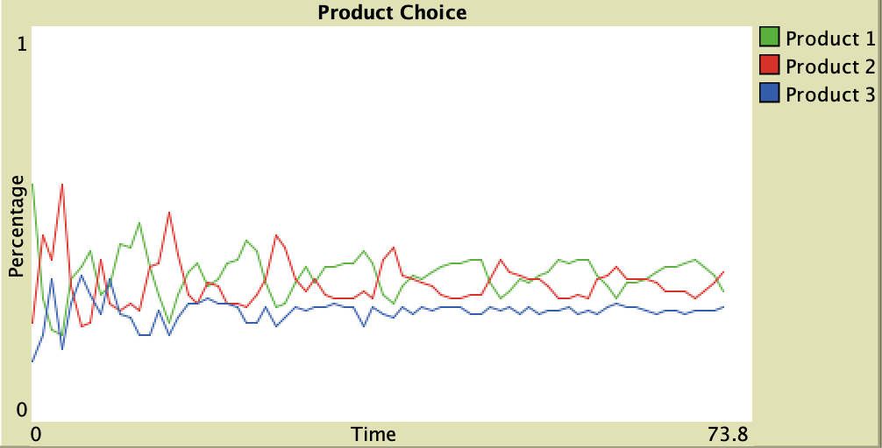
P1 = 50
P2 = 50
P3 = 50
P1 = 60
P2 = 50
P3 = 40
P1 = 65
P2 = 50
P3 = 35
P1 = 60
P2 = 60
P3 = 40

Slide 25
Generated Results
The pattern of fluctuation is periodic. Based on Experiment 1, the period is decided by the Memory Size, which means if every agent takes into account more history, then the period will generally be longer.
The market fluctuates with randomness. Based on Experiment 2, if every agent has more strategies to choose from, then the randomness of the market will be higher.
Based on Experiment 3, products with higher default prices are generally more popular than products with lower default prices.

Slide 26
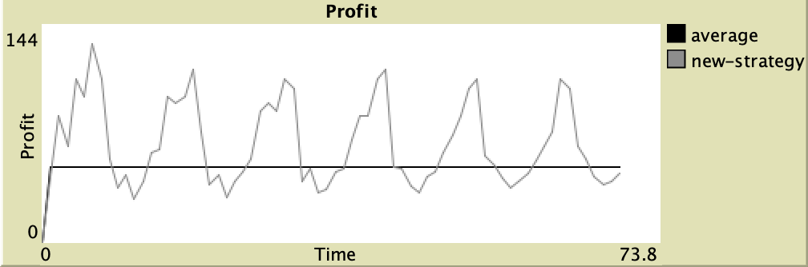
New Strategy
Since we confirm that there exists a periodic fluctuation pattern, we make our new strategy have the first round in the previous period as a dominating factor, which means the weight in the strategy for the first record in the memory is larger.

Slide 27
Discussion & Conclusion
The results align well with our expectation. Based on our model, we can easily predict which product will bring more profits in the next round. Investors can thus make good decisions. However, the real situation is much more complicated than our model. There are other factors and the number of products is far more than 3.
The market does fluctuate with a certain periodic pattern. If we can develop a more complicated and more intelligent model, then it can help us make investment decisions in real situation.

Slide 28
References
Damien Challet, Matteo Marsili, Yi-Cheng Zhang, Modeling market mechanism with minority game, PhysicaA 276 (2000), pp. 284-315
Damien Challet, Yi-Cheng Zhang, On the minority game: Analytical and numerical studies, PhysicaA 256 (1998), pp. 514-532
Jona Linde, Joep Sonnemans, Jan Tuinstra, Strategies and evolution in the minority game: A multi-round strategy experiment Games and Economic Behavior, Volume 86 (2014), pp. 77-95

